Slide 1
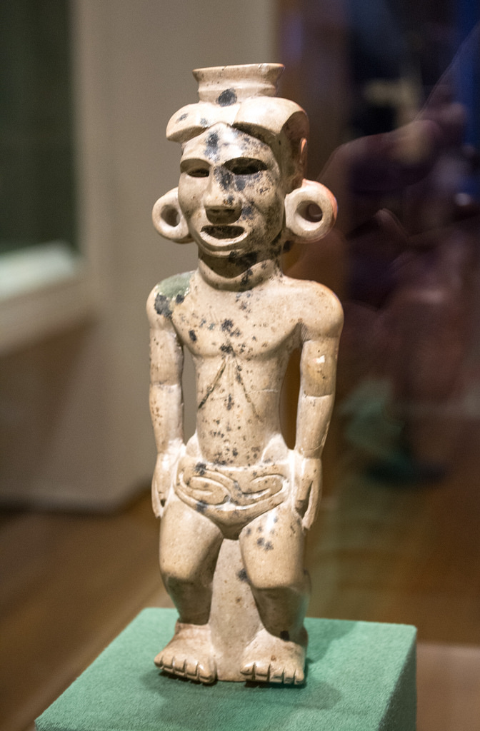
MuseumDekho.com

Slide 2
IDEA DESCRIPTION
The web app provide the information about the various artefacts of the museum.
Our app will eliminate the need of the guide thus saving the time and money of the museum authority.

Slide 3
IDEA IMPLEMENTATION
We Used QR scanner for embedding the information of the artefacts and the relevant information of the artefact is provided to the user in audio form
We also add the 3D view of the artefacts using the AUGMENTED REALITY for better representation of artefacts.

Slide 4
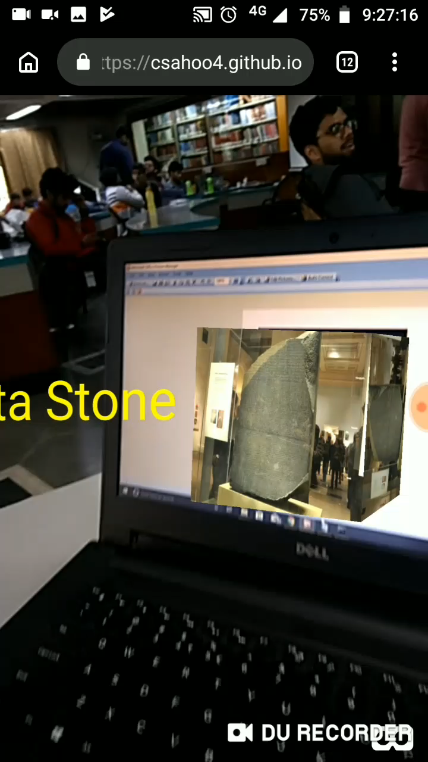

Slide 5
TECHNOLOGY STACK
Html 5
CSS
JavaScript
Ar.js

Slide 6
Future Work
Implementation Of the web app on production scale.

